Slide 2
What is BestShine Edu App?
Management
Driver
Teacher
Student
Parent
BestShine Edu App, the unique school management for
Student, teacher, parent & driver real time connecting system

Slide 3
Why shine school app ???
BestShine Edu App provides a Real Time Connecting System
Update of your kids on the move and live
One stop shop for 360’c update of your kid
Connects all the interfaces of schools element and environment
BESTSHINE EDU APP KEEP YOU INFORMED

Slide 4
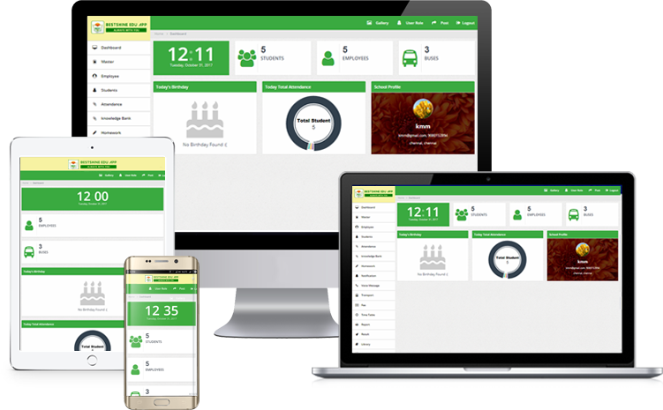
We Communicate
School Management
Parent
Teacher
Student
Driver

Slide 5
Who Can Use BestShine Edu App

Slide 6
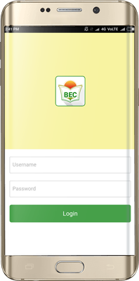
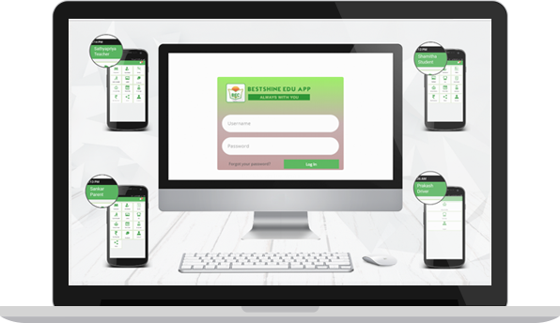
BestShine Edu App
WEB ADMIN
MOBILE APP

Slide 7
APP LOGIN
BestShine Edu App provides username and password for Teacher, Parent, Student,
Driver and School Management

Slide 8
TEACHER HOME SCREEN

Slide 9
PARENT HOME SCREEN

Slide 10
STUDENT HOME SCREEN

Slide 11
DRIVER HOME SCREEN

Slide 12
DASHBOARD

Slide 13
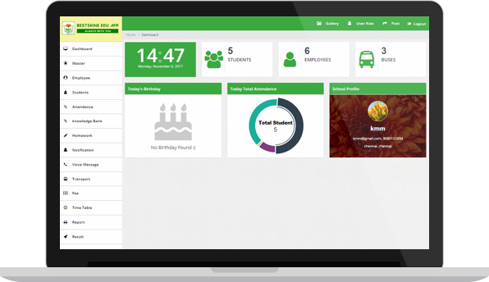
DASHBOARD
Shows summary of whole school in a single page
Single screen you can view all the features of the App.
Complete Attendance Report of class wise in graphical representation

Slide 14
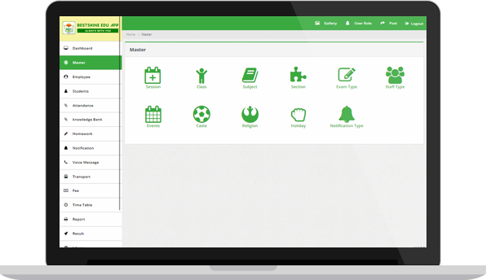
MASTER
Module categories like:
Events (Sports, Cultural Program etc.)
Subjects (English, Hindi etc.)
Class (First, Second etc.)
Exam Type (First Term, Session, Half Yearly etc.)
Staff Type (Principal, Teacher, Accountant etc.)

Slide 15
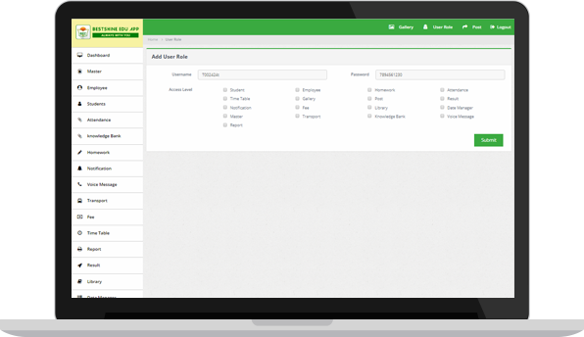
USER ROLE
Access to management
For non teaching Staff, Management Staff based on the rights they will play role
For EX: Library staff can have Access to use library whereas the library staff can’t have access to use fee management

Slide 16
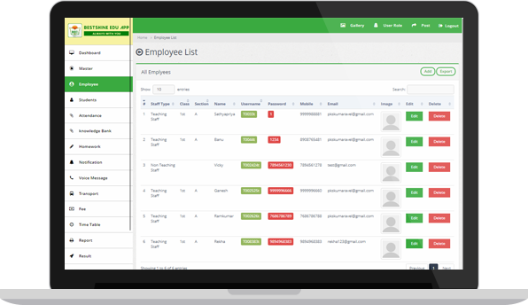
EMPLOYEE DASHBOARD
In Single Screen you can see all details of employee i.e.Name,Email,Mobile Num etc.,
In this page you can Create, Update, or Remove Employee
Get Username & Password for all Employee.

Slide 17
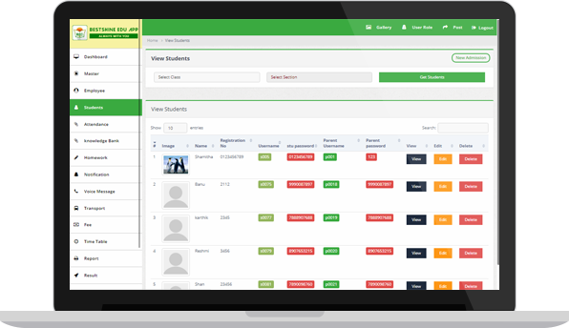
STUDENT DASHBOARD
In Single Screen you can see all details of Student i.e.Name,Register No, Username & Password etc.,
For Parent Username & Password also visible
In this page you can Create, Update, or Remove Student

Slide 18
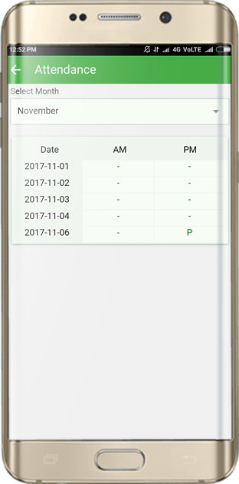
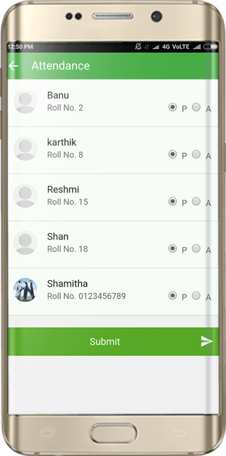
ATTENDANCE
Parent and Student can check daily base attendance or for whole month
Teacher can mark attendance
absent or present for student

Slide 19
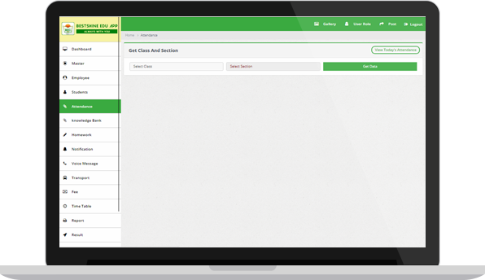
ATTENDANCE
Teacher/Admin can mark attendance Class wise or Student wise.
If any modification in attendance the admin alone has the rights to modify

Slide 20
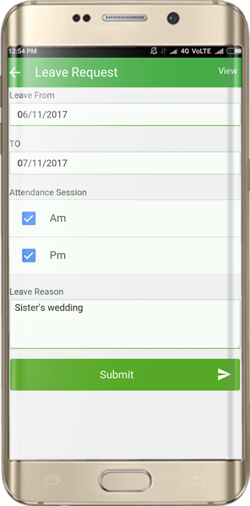
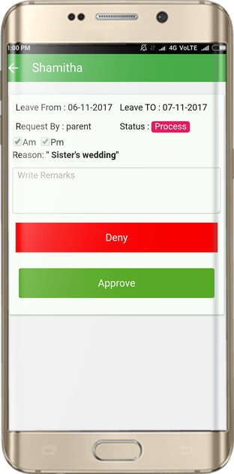
LEAVE REQUEST
Parent can send the leave request by entering valid credentials
Teacher can Approve/Deny the leave request

Slide 21
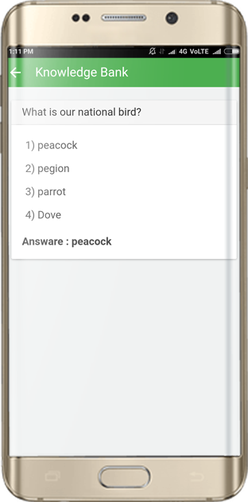
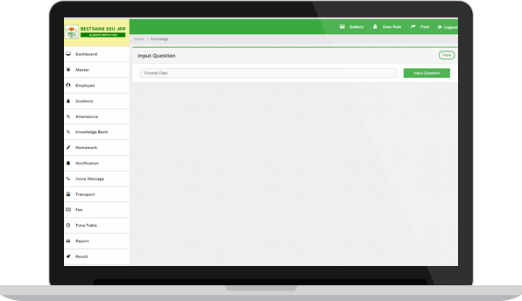
KNOWLEDGE BANK
Parent and Student can
check daily base question
and answer for his/her child
Teacher will create aptitude question and answers for every subject

Slide 22
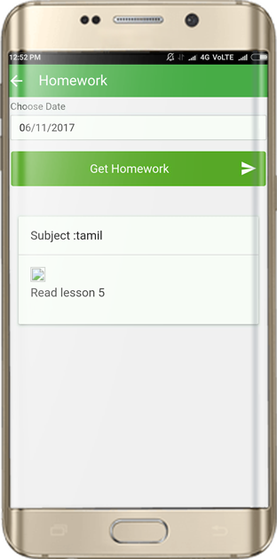
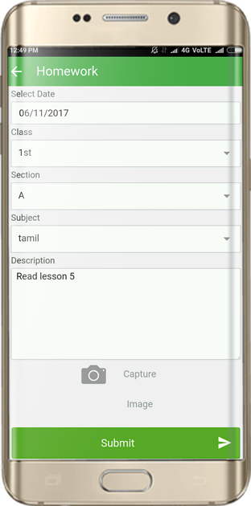
HOMEWORK
Parent and Student can stay update of Homework or Assignment
Teacher can send Homework or Assignment for student

Slide 23
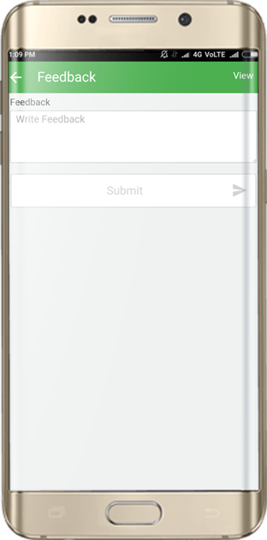
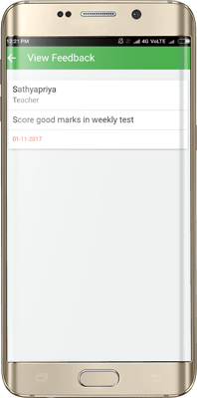
FEEDBACK
Teacher can send/receive feedback from Parent of
his/her child performance
Parent also can send/receive feedback for his/her child performance to Teacher

Slide 24
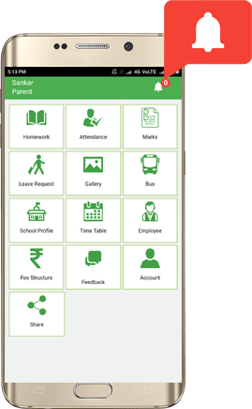
NOTIFICATION
Parent and Student can get:
Fee Notification
Exam Notification
Events Notification
Leave Approved/Denied Notification
Parents meeting Notification and more……
Teacher will receive:
Leave Request Notification

Slide 25
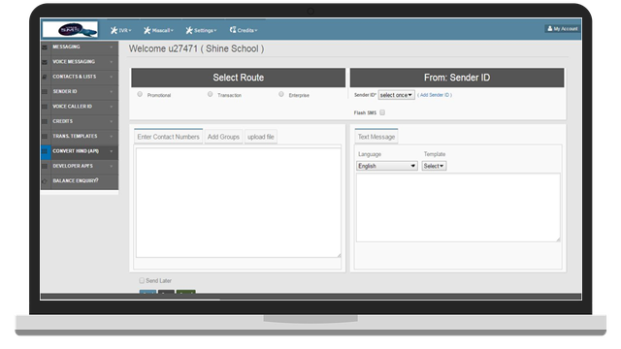
VOICE SMS
In a Single Instance
You can send a voice call to every one to intimate information
For Eg: Tomorrow is holiday due to rain

Slide 26
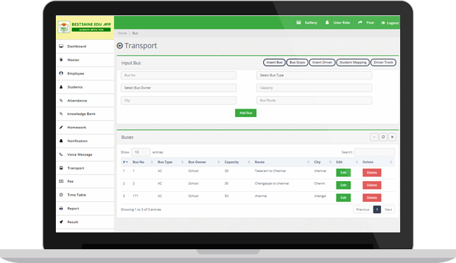
TRANSPORT
Complete control of Bus fleet for the management and parent.
User can add, update , delete and view for buses, routes and stops.
User can add, edit, delete and view for driver details
User can assign bus by route wise and track by bus location.

Slide 27
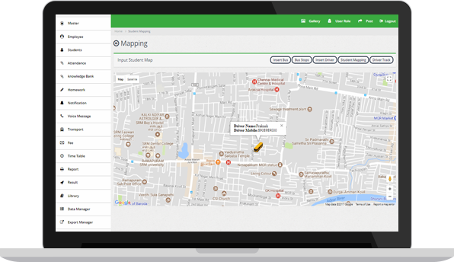
BUS ROUTE
View all Buses and their Route Detail by current running location as well as particular stop

Slide 28
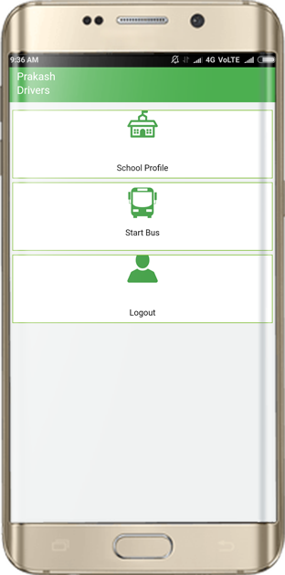
Driver App
Driver will start bus & he will login Driver app, simultaneously Student and Parent can track the bus

Slide 29
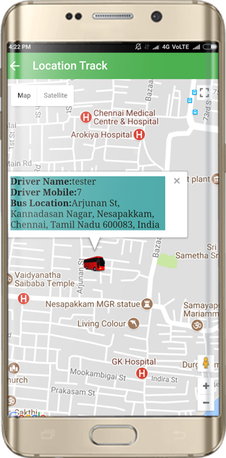
BUS TRACKING
Parent and Student can get:
Bus Driver Details
Bus Route/Stop
Real-Time Bus Track

Slide 30
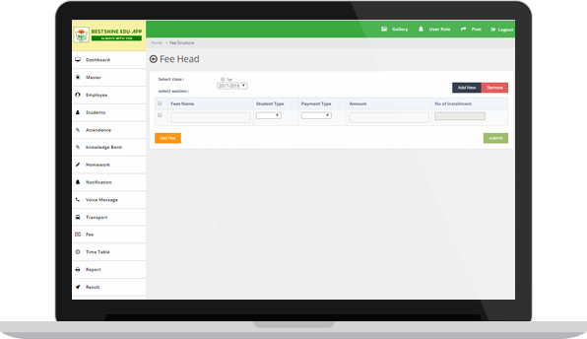
FEE STRUCTURE
Create fee is classify into two type fee structure and fee collection.
In Fee Structure school based fee is present i.e payment submit all type of Fees from one place and in one click, In Fee collection enter the register no and get all the detail of Student Fee Detail
You also get printout for receipt

Slide 31
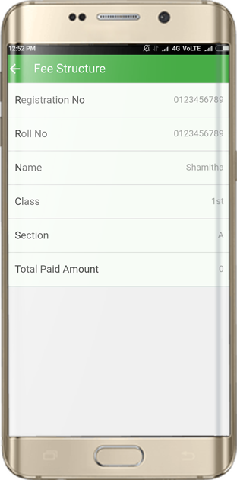
FEE STRUCTURE
Parents can check regularly
updated fee paid detail as per
schedule of parent and
management

Slide 32
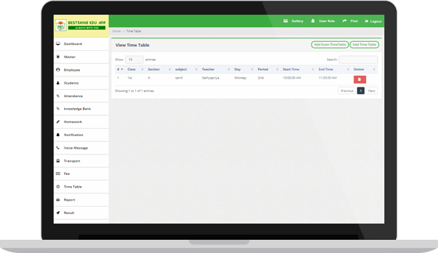
TIME TABLE
Admin can create time table as per schedule of management such as daily ,period , subjects and time.
Admin User can create Exam time table as per schedule of Exam Terms

Slide 33
REPORT
The cumulative document contains differentiated statement covers all report.
Report includes Attendance, Library, Student, Student Performance, Teacher Performance and Fee Collection

Slide 34
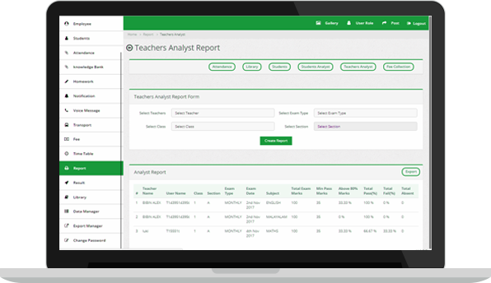
TEACHER PERFORMANCE
Is an authentic, contextualized measure of Teacher’s ability of analyze Student’s.
And also you get the individual Performance of Teacher.

Slide 35
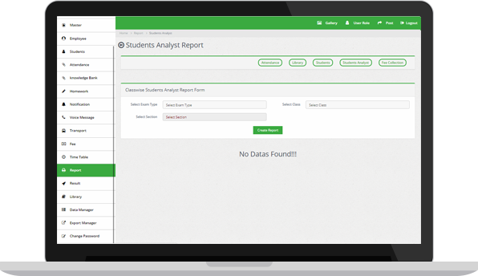
STUDENT PERFORMANCE
Make easy for Teacher, Principal & Parent to check the Progress Report of any Student anytime by logging.

Slide 36
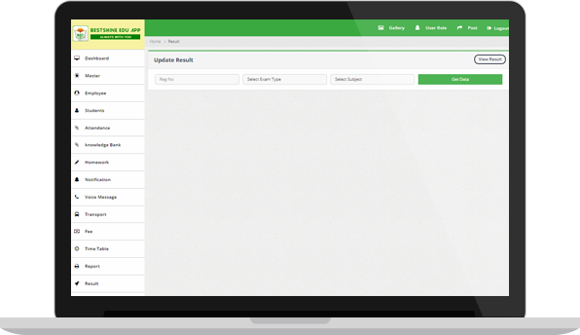
RESULT/MARKS
Class wise result can be view, add and update
Manage Grade setting(Create, Update, Delete)
Individual Student wise result Can be update

Slide 37
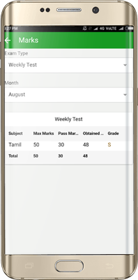
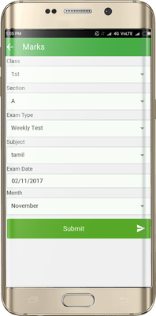
RESULT / MARK
Parents and Students can check academic performance i.e, marks, Grade and Pass/ Fail using his username.
Teachers can send marks, Grade and
Pass/ Fail with student wise for his
class.

Slide 38
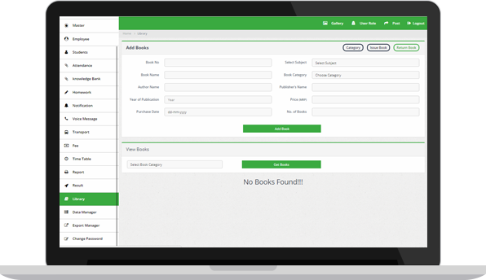
LIBRARY
View Books inventory details
Add, Delete, Update Books
Issue/Return books to and from student or Teacher
Manage Books by all category
Search books, Sort books with search
functionality

Slide 39
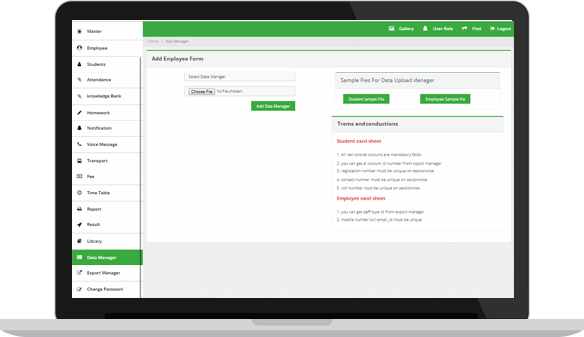
DATA MANAGER
We can enter multiple student /Employee profile in a single instance
Instead of uploading one by one

Slide 40
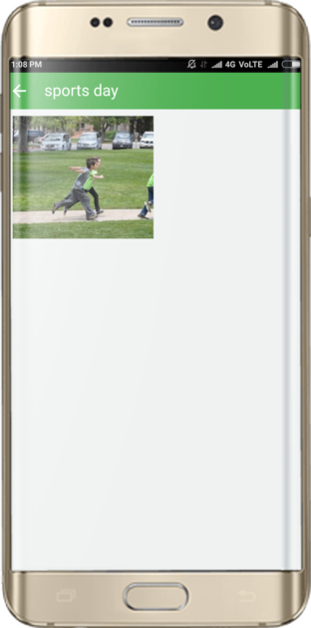
GALLERY
In this section Parent and Student can see various images regarding cultural program, events, architecture and more… using his username
View all event pictures
Manage pictures like ADD & DELETE
Upload pictures under available categories
Add Description to the pictures

Slide 41
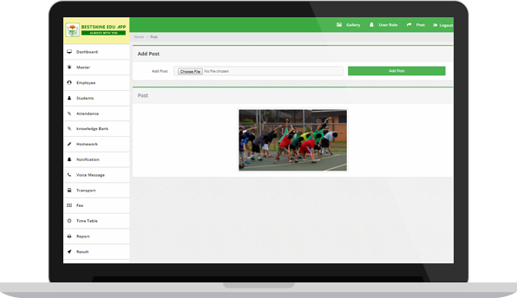
POST
Text audio and multimedia post enhanced in the app.
Instant share of school profile picture on Mobile App splash screen.
Upload the picture, Add Description

Slide 42
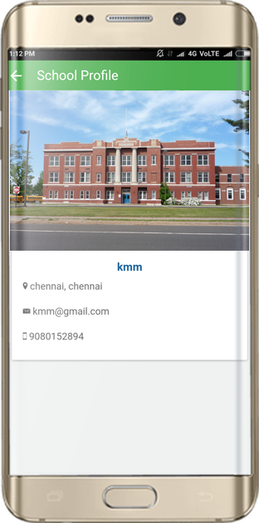
SCHOOL PROFILE
Parents and Students can see the detail profile of the school like :
Name of school
Address
Email ID
Contact No
School image

Slide 43
BENEFIT FOR MANAGEMENT
Dashboard
Post
Master
Employee
Student
Gallery
Data Manager
Holiday
Library
Grade System
Notification
Transport
Fee Structure
Result
Report
Voice SMS
Text SMS
Bus Tracking
Student Analyst
Teacher Analyst

Slide 44
BENEFIT FOR STUDENTS, PARENTS & TEACHERS
ADMISSION PROCESS
STUDENT DATA
STAFF DETAILS
FEE PROCESS
SMART ATTENDANCE
SMART HOMEWORK
EXAM & RESULT PUBLICATION
MESSAGES AND PUSH NOTIFICATIONS
LIBRARY MODULE
REPORT MANAGER
TIMETABLE

Slide 45
BENEFIT FOR STUDENTS, PARENTS & TEACHERS
STUDENT FEEBACK
LEAVE REQUEST
STUDENT BUS TRACKING
Parent Bus Tracking
Admin Bus Tracking
PHOTO GALLERY
KNOWLEDGE BANK
VOICE SMS
SHARING ALL TYPE OF POST
Transport Admin Management
Teacher Performance Report
Student Performance Report

Slide 46
Just Now Free Download This App From Play Store
“BestShine Edu App”
Thank you for your valuable time
Contact Us: +91-63803-52803 | www.ShineSchoolapp.com
BestShine Education Campus Private Limited
C-383, First Floor ,Ramphal Chowk, Sector-7,Dwarka,New Delhi

